Slide 1
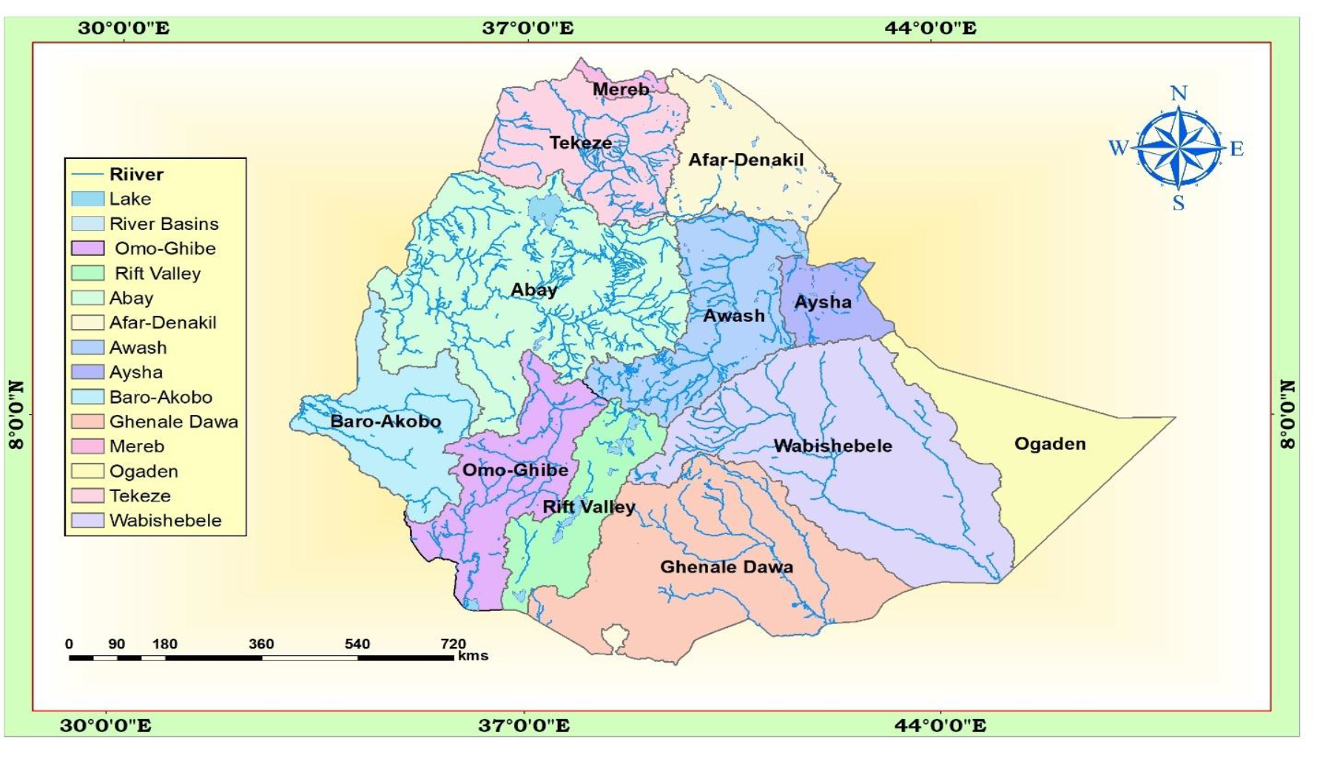
CHAPTER FOUR
DRAINAGE SYSTEMS AND WATER RESOURCE OF ETHIOPIA AND THE HORN

Slide 2
4.1. Introduction
About 71% of the earth's total surface is covered by water bodies majorly occupied by seas and oceans.
Of the earth's total water surface, nearly 97.5% is alkaline accumulated in seas and oceans.
The remaining 2.5% is fresh water, of which nearly 68.7% is deposited in glaciers, 30.1% in ground water, 0.8% in permafrost and 0.4% in surface waters.
Water in lakes, rivers, atmosphere, soils and wetlands are considered as surface waters. Surface and ground waters are by far the most abundant and easily available fresh waters.
However, fresh water is distributed unevenly throughout the world following varied latitudinal locations, climatic and topographic setups.
The countries water potential is estimated to be 124.4 billion cubic meters (BCM)…. But requires further investigation.

Slide 3
4.2. Major Drainage System of Ethiopia
The flow of water through well-defined channel is known as drainage
A drainage system is made up of a principal river and its tributaries
A river system begins at a place called the source or headwater and ends at a point called mouth
The drainage pattern of an area is the outcome of:-
The geological processes,
Nature and structure of rocks,
Topography, slope,
Amount and the periodicity of the flow.
A drainage basin is the topographic region from which a river and its tributaries collect both the surface runoff and subsurface flow.

Slide 4
Cont.….
The general patterns of major river basins in Ethiopia are determined by topographical structures which can be clarified as:
a. The topography of the outward sloping of the Western and South eastern plateaus
b. The structural formation of the Rift Valley with its in-ward-sloping escarpments resulting mainly in an inland drainage system.
c. Faults and joints that structurally influence part of the courses of many rivers.

Slide 5
The Major Drainage Systems
Following the complex physiographic setup and geological makeup, Ethiopia possesses three broadly classified drainage systems namely
Western,
South-eastern and
Rift Valley Drainage Systems

Slide 6
4.2.1. The Western Drainage Systems
The largest of all drainage systems draining 40% of the total area of the country and carry 60% of the annual water flow
This drainage system comprises four major river basins namely
Tekeze,
Abay,
Baro-Akobo,
Ghibe (Omo).
The Ghibe (Omo) flows southward.
The Abay, Tekeze and Baro flow westward ultimately joining the Nile which finally ends at Mediterranean Sea.

Slide 9
4.3. Water Resources: Rivers, Lakes and Sub-Surface Water
4.3.1. The Ethiopian Rivers
Ethiopia is endowed with many rivers.
Majority of the rivers originate from highland areas and cross the Ethiopian boundary.
form 12 major watersheds, separating the Mediterranean Sea from the Indian Ocean drainage systems.

Slide 10
49.5 BMC

Slide 11
General Characteristics of Ethiopian Rivers
Owing to
The highland nature of the Ethiopian landmass,
Surface ruggedness,
The outward inclination of the highlands, and
The climatic conditions, Ethiopian rivers have the following characteristics.
Almost all major rivers originate from the highlands elevating more than 1,500masl,
➢Majority of Ethiopian rivers are trans-boundary,
Extreme seasonal fluctuation.
They have rapids and waterfalls along their course,
➢They have cuts, steep-sided river valleys and deep gorges along their courses,
flow on steep slopes having steep profiles.
➢ Some of the rivers serve as boundaries, both international and domestic administrative units.

Slide 12
4.3.2. The Ethiopian Lakes
Relatively Ethiopia is rich in lakes. Almost all Ethiopian lakes are result of tectonic process that took place during Quaternary period of Cenozoic era.
Majority of lakes are located within the Rift Valley System.
The lakes in the drainage are mainly formed on faulted depressions and are clustered along the system forming linear pattern.
Lake Tana, the largest lake in Ethiopia, occupies a shallow depression in the highlands.
The Tana depression is believed to be formed following slower sinking and reservoir by lava flow between Gojjam and Gonder massifs.

Slide 13
4.3.2. The Ethiopian Lakes ……….
Ethiopia is also gifted with crater lakes. These include the lakes at and around Bishoftu, Wonchi (near Ambo), Hayk (near Dessie) and the Crater Lake on top of Mount Zikwala.
Lake Ashenge (Tigray) is formed on a tectonic basin.
Other types of lakes in Ethiopia are man-made such as Lakes Koka, Fincha and Melka Wakena, and many other lakes dammed following hydroelectric power generation projects.
See Figure 4.2. Lakes of Ethiopia ….next slide

Slide 15
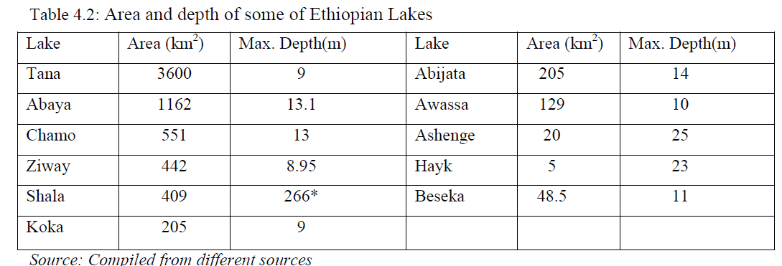
Cont.……
Cluster of lakes are lined up within main Ethiopian rift. Lake Abaya is the largest of all the lakes in the system.
The southern tip of the Rift Valley forms the marshy land called the Chew Bahir which is drained by Segan and Woito.
Shala and Ziway are the deepest and the shallowest lakes in the central Ethiopian Rift respectively.

Slide 16
4.3.3. Subsurface (Ground) Water Resource of Ethiopia
As compared to surface water resources, Ethiopia has lower ground water potential.
However, there exists higher total exploitable groundwater potential.
Based on existing scanty knowledge, the groundwater potential of Ethiopia is estimated to be 2.6 - 6.5 BMC.
However, this estimate is now considered underestimated. Considering various separate studies, Ethiopian potential of groundwater is believed to range between 12-30 BMC.

Slide 17
4.4. Water Resources Potentials and Development in Ethiopia
a) Hydro-electric Potential
Ethiopian rivers have a very high potential for generating electricity.
The exploitable potential of hydroelectric power is estimated at about 45,000 megawatts.
The first hydroelectric power generation plant was installed on Akaki River (Aba Samuel) in 1932.
Grand Ethiopian Renaissance Dam (GERD) is the country's largest dam under construction aiming to generate 6,400 megawatts.
Gilgel Gibe III hydropower project has gone operational generating 1,870 megawatts.
Currently Ethiopia is administering 14 hydroelectric power plants constructed on Lake Aba Samuel, Koka, Tis Abay, Awash, Melka Wakena, Sor, Fincha, Gibe/Omo, Tana Beles and Tekeze, generating close to 4000 megawatts of energy

Slide 18
a) Hydro-electric Potential….
Besides the domestic use of generated electricity, the country is exporting electricity to the neighboring countries.
The major problem related to the use of Ethiopian rivers for the generation of hydroelectric power is
The seasonal flow fluctuations and impact of climate change and variabilities and
The severe erosion from the highlands and sedimentation in the reservoirs is also a critical problem for hydroelectric power generation

Slide 19
b) Irrigation and Transportation
The terrain in Ethiopia is so rugged that it limits the uses of Ethiopian rivers both for irrigation and transportation.
In the highlands, steep slopes, rapids, waterfalls, narrow and deep valleys and gorges are important obstacles.
But on the lowlands, their demand for irrigation is high.
Regardless of existing physiographic setups, Ethiopia's potential of irrigation is estimated to be 5.3 million hectares.
The Baro-Akobo and Genale Dawa river systems have large irrigation potential compared to other basins.
more than 60% of the area under irrigation so far is located in Rift Valley Drainage System.

Slide 20
b) Irrigation and Transportation ….
Majority of Ethiopian rivers are not suitable for transportation.
The Baro at its lower course is the only navigable river.
Comparatively, Ethiopian lakes are much suitable for transportation than rivers.
Lake Tana and Abaya are relatively the most used for transportation.

Slide 21
c) Fishing and Recreation
The majority of Ethiopian lakes are rich in fish.
Currently the annual production of fish is estimated to be 31.5 thousand tons.
The exploitable potential is however, by far greater than the current production.
Currently Lake Tana leads the potential by estimated 8,000-10,000 tons per year.
Fish production from Lake Chamo is estimated at 4,500 tons per year. However, more than 60% of fish supplies are coming from Ethiopian main Rift Valley lakes.
Some of the lakes are currently threatened by sedimentation, invasive species (water hyacinth), over exploitation and expansion of investments around lakes.

Slide 22
c) Fishing and Recreation…
There are a variety of fish, birds and other aquatic life forms in the lakes.
This and the scenic beauty of the lakes, the hot springs around them, the spectacular river gorges and the most impressive waterfalls make Ethiopian rivers and lakes important recreational and tourist attractions.
As they are the natural habitat of a variety of wild life, some of which are only endemic to Ethiopia, their value for scientific purposes is immense

